Slide 1
Revisiting the Effect of Food Aid on Conflict
Paul Christian (World Bank)
and
Christopher B. Barrett (Cornell)
Department of Economics Seminar
Tufts University
March 28, 2017

Slide 2
Background
Motivation
Nunn and Qian (2014) use a novel IV strategy to identify what they claim is a causal effect of US food aid deliveries on conflict in recipient countries.
Substantive contribution: “a 1,000 MT increase in US wheat aid increases the incidence of conflict by .3 percentage points.” (~+4% avg conflict incidence at sample means). Very serious.
Methodological contribution: Uses a (continuous ) DID-like strategy to generate 1st stage plausibly exogenous variation in the variable of interest (food aid shipments).

Slide 3
Policy Motivation
Motivation: Food Aid Policy
The US is by far the largest global provider of food aid.
If US food aid causes conflict, further reduction of an already- controversial program might be warranted.
Sample coverage of N&Q results:
“Cash for conflicts: New research suggests that development projects and food aid have fueled civil conflicts” (The Economist)
“Please, Don’t Send Food” (Foreign Policy)
“Why Food Aid Fuels International Conflict” (Huffington Post)
Meanwhile, UN warns that cuts to food aid are “threatening to worsen already unacceptable levels of acute malnutrition, stunting and anemia, particularly in children.”

Slide 4
Methodological Motivation
N&Q use a clever IV strategy increasingly used by others (e.g., Peri 2012 REStat, Dubé & Vargas 2013 REStud, Hanna & Oliva 2015 JPubEcon)
But plausibly exogenous variation comes from just n=36 time series observations… maybe just spurious correlation?
N&Q use (potentially endogenous) cross-sectional heterogeneity in response to exogenous inter-annual variation to identify causal effects … a diff-in-diff approach.
But is interaction term exogenous conditional on controls?
Problem: L-R time series trends dominate S-R exogenous variation and violate (non-linear) parallel trends assumption.

Slide 5
Talk Outline
Outline for rest of talk:
N&Q estimation strategy
Intuition of potential problems with strategy
US policy changes: placebo test #1
Randomize variable of interest: placebo test #2
Use a clearly spurious IV: placebo test #3
Monte Carlo evidence

Slide 6
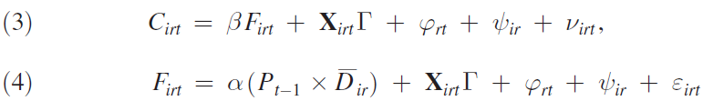
N&Q Strategy
Estimate conflict as function of (endogenous) food aid receipts, given controls, incl. region-year and country fixed effects.
Policy generates random variation: “USDA accumulates wheat in high production years as part of its price stabilization policies. The accumulated wheat is stored and then shipped as food aid to poor countries.” Exogenous shocks to wheat production change food aid at margin, primarily among regular food aid recipients.
Identification:
“US wheat production is associated with more conflict among regular US food aid recipients but not among irregular recipients.”

Slide 7
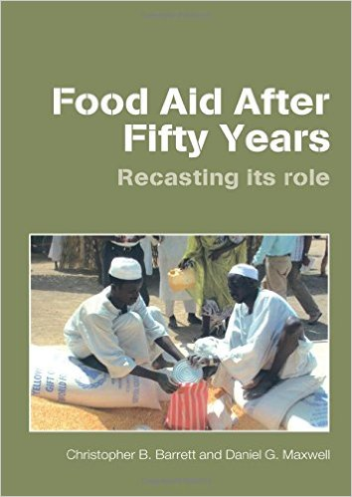
N&Q Strategy
OLS results: negative, insignificant relationship b/n food aid flows and conflict. But potentially endogenous if food aid flows targeted partly on basis of conflict status (per policy).
N&Q argue that OLS estimates downwardly biased because food aid targeted to countries less affected by conflict (where it is least likely to cause harm).
Really? Darfur 2004:

Slide 8
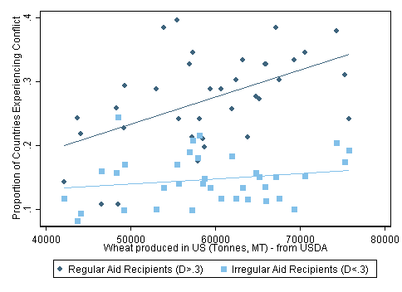
N&Q Strategy
Preview: The N&Q Strategy
A visual representation of N&Q’s results:

Slide 9
Potential problems
Food aid is targeted to (not away from) conflict-affected countries per USAID policy:
“[USAID Food for Peace] provides emergency food assistance to those affected by conflict and natural disasters and provides development food assistance to address the underlying causes of hunger.” (2015, emphasis added)
2. Effectively leveraging n=36 inter-annual observations of wheat production fluctuations … longer-run trends may dominate year-on-year change from mechanism N&Q posit.
3. N&Q mechanism (USG wheat purchases based on price support policy) only existed for part of the period they study.

Slide 10
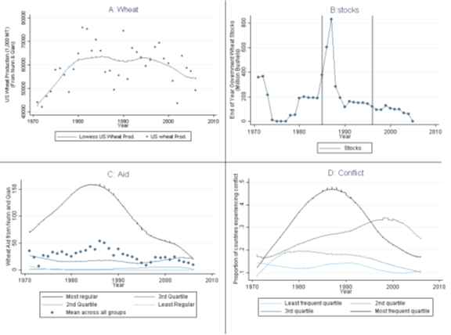
Potential problems
Preview: The Problem

Slide 11
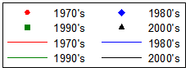
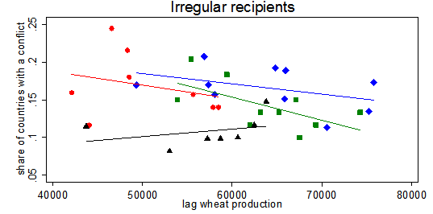
Potential problems
Preview: The Problem
The difference between regular and irregular recipients occurs solely in 1970s, during transition to period of high US wheat output and conflict.

Slide 12
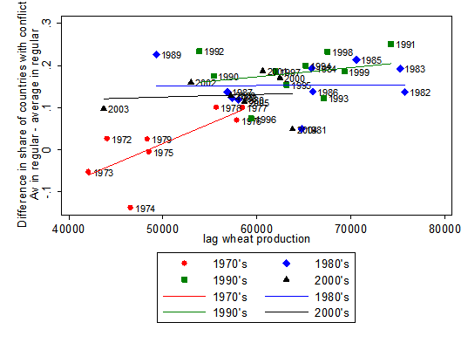
Potential problems

Slide 13
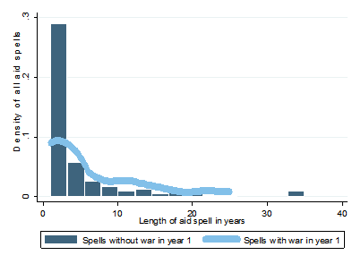
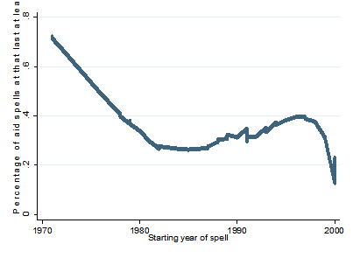
Potential problems
Food aid flows are persistent, especially if a food aid spell begins in a year of conflict. If food aid is targeted to conflict-affected countries, it is therefore endogenous. Persistence dampens over study period, so problem greatest in 1970s.

Slide 14
Placebo test #1
N&Q’s policy drivers changed dramatically from 1971-2006.
1970’s: CCC offered non-recourse loans. Farmers could forfeit grain to pay off loan. So as prices↓ → wheat stocks ↑.
Only real fluctuations around market prices were 1981-87.
1985 Farm Bill lowered price target dramatically making forfeiture less attractive
1996 Farm Bill eliminated price targets entirely
CCC stocks of wheat completely exhausted by 2006.
Also shift from T1 to T2 PL480 food aid from 1970s-2000s
Implication:
N&Q strategy should work pre-1985, not at all post-1996.

Slide 15
Placebo test #1
1st stage instrument becomes insignificant in relevant (pre-1985) period; 2SLS estimate unchanged (but insig).
But placebo test period (post-1996) not stat sig different from relevant (pre-1985) period.
First hint that something else drives relationship: procurement policy does not drive N&Q results.

Slide 16
Placebo test #2
Longer-run (nonlinear) trends in time series dominate inter-annual exog variation that drives identification. Endog. group selection plus trends could fully explain N&Q results.
Year-region/country fixed effects not adequate controls.
Placebo test: randomizing food aid flows among recipients should break link unless background trends drive correlation.
Implication:
If coefficient estimate on randomized food aid still positive and statistically significant, it’s picking up something else, (i) endog. identity of regular aid recipients and (ii) spurious background trends in conflict and wheat production.

Slide 17
Placebo test #2
Placebo Test Method:
- Hold constant identity of aid recipients, timing and total availability of food aid, wheat production, etc.
- Randomize which country receives food aid flow each year.
- This preserves the endogenous macro time trends and the potential spurious correlation of wheat production and conflict.
- Also retains potential ORV and selection bias problems.
Implication:
If N&Q’s hypothesized mechanism is true, this randomization should break correlation between food aid flows and conflict.

Slide 18
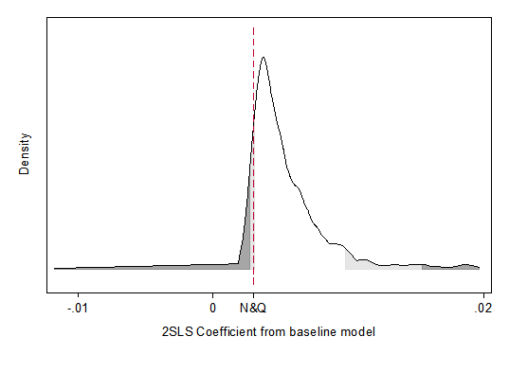
Placebo test #2
Dist’n of coefficient estimates from 1,000 randomizations does not center around 0. Instead, it moves rightward!
Implication:
(Endogenous) identity of FA recipients and background trends drive N&Q result, not the policy mechanism they posit.

Slide 19
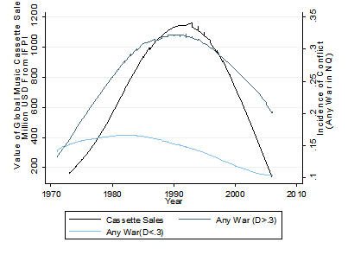
Placebo test #3
Given those results, try replicating N&Q with a clearly spurious IV with the same trend that can’t possibly cause food aid flows.
We use global music cassette sales as spurious IV. Even when control for N&Q’s instrument, this spurious IV generates very similar estimates (0.3%) to (not stat sig different from) N&Q’s!
Take-away: Any time series variable with a spuriously similar trend yields biased IV estimates, even with lots of controls.

Slide 20
Monte Carlo tests
We construct 2 models where food aid has no positive effect on conflict: (i) uncorrelated, and (ii) food aid reduces conflict.
If we preserve the background trends, and L-R variation > S-R variation in exogenous component of IV, do we estimate the same negative OLS but positive IV relationship?
In such a model, does N&Q’s estimation strategy accurately reflect the true DGP?
Take-away:
Using, N&Q’s strategy, we consistently replicate their findings of negative OLS estimates and positive 2SLS estimates when there is no true positive, causal effect of food aid on conflict.

Slide 21
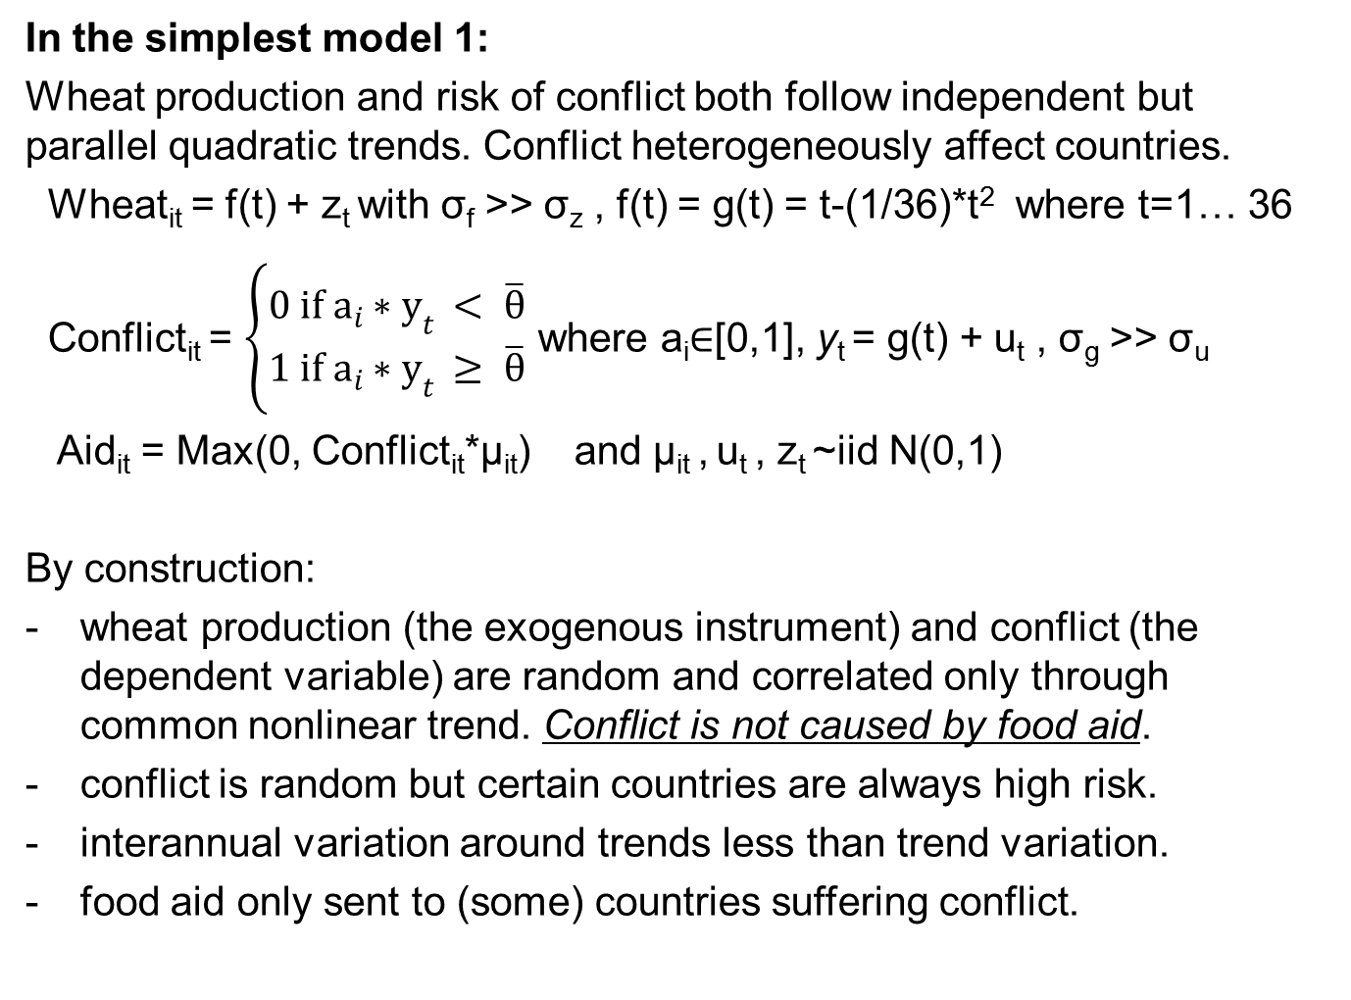
Monte Carlo tests
In the simplest model 1:
Wheat production and risk of conflict both follow independent but parallel quadratic trends. Conflict heterogeneously affect countries.
Wheat­_{it} = f(t) + z_{t} with σ_{f} >> σ_{z} , f(t) = g(t) = t-(1/36)*t² where t=1… 36
Conflict_{it} = $\left\{\begin{matrix}0 if a_{i}∗y_{t} < \overline{θ} \\ 1 if a_{i}∗y_{t} ≥ \overline{θ}\end{matrix}\right.$ where a_{i}$∈$[0,1], y_{t} = g(t) + u_{t} , σ_{g} >> σ_{u}
Aid_{it} = Max(0, Conflict_{it}*μ_{it}) and μ_{it} , u_{t} , z_{t} ~iid N(0,1)
By construction:
wheat production (the exogenous instrument) and conflict (the dependent variable) are random and correlated only through common nonlinear trend. Conflict is not caused by food aid.
conflict is random but certain countries are always high risk.
interannual variation around trends less than trend variation.
food aid only sent to (some) countries suffering conflict.

Slide 22
Monte Carlo tests
When we generate 100 random samples of 126 countries and 36 years, we get the following key variables:
Conflict is random but certain
countries are always high risk
risk is high in middle period
Wheat yield also follows an
inverse-U shape with little
variation around the trend

Slide 23
Monte Carlo tests
Despite true β=0, N&Q’s 2SLS estimation strategy generates biased sampling dist’n of the parameter estimates of interest:
Main robustness check (including lagged conflict status) actually makes the bias worse.

Slide 24
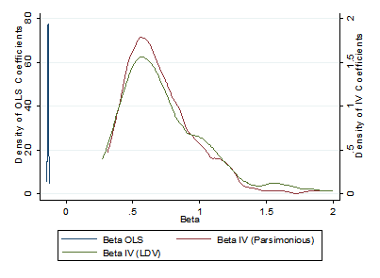
Monte Carlo tests
Model 2: more realistically allow food aid to be driven in part by reasons other than conflict. Also let food aid receipts prevent conflict in the true DGP.
Resulting parameter estimates for OLS and 2SLS are exactly like N&Q’s even though true β<0!
Two core problems: (i) countries that experience the most conflict are most likely to get aid and (ii) conflict and wheat production are spuriously related over time.

Slide 25
Conclusions
Food aid: N&Q’s findings not causal. Indeed, fully consistent w/ a model in which food aid prevents rather than causes conflict.
Methodological: Other papers use similar IV strategy: interact a plausibly exogenous time series variable with limited variation with a potentially endogenous cross-sectional variable with greater N to create continuous quasi-DID IV estimator. Be wary!
Know true data generating process (e.g., policy) and any changes during the period
If diff-in-diff ‘treatment’ is likely endogenous be very careful to look for differences in underlying trending variables. Plot data and inspect visually for non-parallel trends.
Try placebo tests to validate exclusionary restriction

Slide 26
Thank you for your interest and comments!

